Slide 1

NANOG 76
HACKATHON
Syed Ahmed
Deepak Padliya
{syed.w.ahmed,deepak.padliya}@oracle.com

Slide 2
Endpoint A
Endpoint A
Endpoint A
Endpoint B
Endpoint B
Endpoint B
Healthy State
Failure
Repaired

Slide 4
Active Monitoring

Slide 5

Agenda
Problem Statement
Goals
Topology Overview
BGP-LS Overview
Networkx
IP GRE Encap/Decap
Exabgp (parser)
Scapy Overview
jq Overview
Visualization - InfluxDB and Grafana

Slide 7
Problem Statement
Mechanisms/tools to identify failures in dense and complicated network
Active monitoring sensors/agents
End-to-end reachability
Packet loss
Latency across the network
Topologies with multiple active paths require increased complexity to ensure coverage of all possible path segments

Slide 8
Problem Statement
Possible best paths between Host A to B in steady state if all links have same cost:
r1-r2-r4-r6
r1-r2-r5-r6
r1-r3-r5-r6
r1-r3-r4-r6
In order to make sure that network is in healthy state, test traffic should take all possible path segments from host A to B

Slide 9
Hackathon Goals
Extract topology information
Build network graph with nodes, links and metrics
Use network graph to compute all best possible paths between two end points
Construct probe packets
Probe all calculated paths
Introduce and account for failure
Bonus
Visualize collected data/metric

Slide 10
Topology Overview
Six device topology using Juniper VMXs
Two ubuntu based Linux hosts connected to R1 and R6.
IS-IS as IGP (feel free to change it to your choice of IGP)
R1 and R6 has BGP-LS configured
ASN: 65535
On host you can run exabgp with R1 or R6 to get BGP-LS info (more on that later)

Slide 11
BGP-LS
BGP-LS is another NLRI of BGP
It uses BGP TLVs to define Objects
Nodes
Links
IP Prefixes
Node Attributes
Node Name
Router-ID
Multi-Topology identifier (etc.)
Links Attributes
Local IP
Remote IP
Local and Remote Router ID
Max Bandwidth (etc.)
IP Prefix
Protocol ID
Local Node descriptor
Prefix Descriptor

Slide 12
BGP-LS (what that actually means)
Collecting Link-State and Traffic Engineering information from IGPs (IS-IS or OSPF) and sharing with external entities using BGP

Slide 13
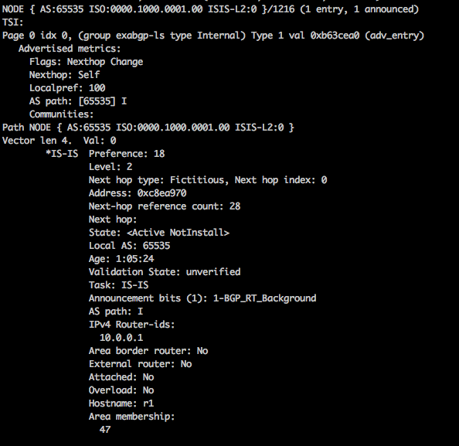
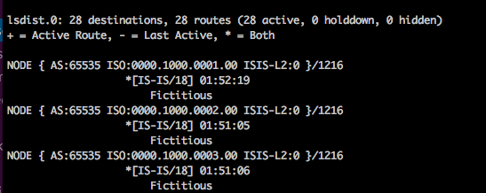
BGP-LS (Node)
Node LS
Router ID
Hostname

Slide 14
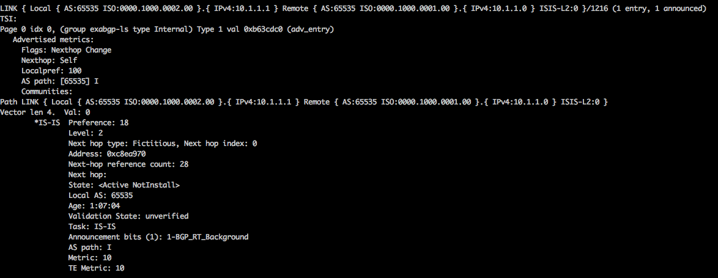
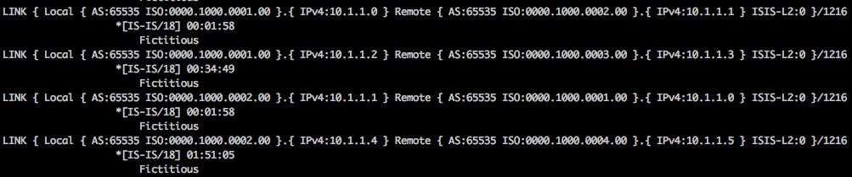
BGP-LS (LINK)
Local IP
Remote IP
Link LS
Metric

Slide 15
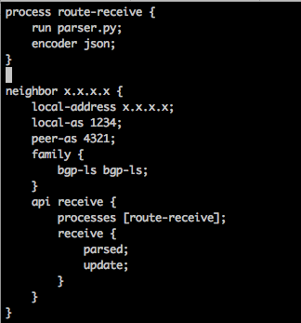
Exabgp Support
Script to parse update
BGP-LS address family on exabgp
Message types to parse

Slide 16
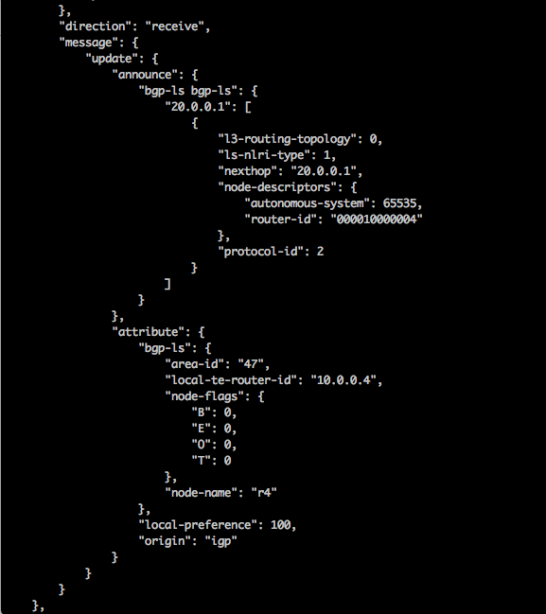
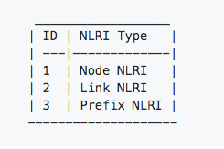
Message Format
Router ID
Options for JSON parsing to glean nodes and links:
Write your own code in programming language of your choice.
Use jq (discussed later).
Router Name

Slide 17
NetworkX
Most languages have Graph libraries like:
Python → NetworkX, iGraph
GoLang → Goraph
>>> import networkx
Sample Graph
Import library
Create new undirected graph
Add new nodes with unique IDs.
Add new edges referencing associated node IDs.
Print details of our newly- created graph.
>>> g = networkx.Graph()
>>> g.add_node("R1")
>>> g.add_node("R2")
>>> g.add_node("R3")
>>> g.add_edge("R1", "R3")
>>> g.add_edge("R1", "R2")
>>> g.add_edge("R2”,"R3")
>>> print g.number_of_nodes() 3
>>> print g.number_of_edges() 3
>>> print g.nodes() ['R1','R2','R3']

Slide 18
IP GRE Encap/Decap
Encapsulate a packet with new outer IP header (source and dest)
After de-encapsulating outer GRE header packet is forward based on inner header
In context of our use-case we are using stateless GRE
Notes:
Config snippet to decap gre decap.

Slide 19
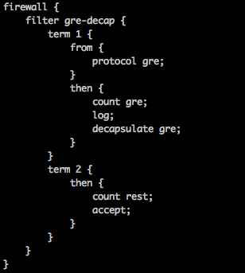
IP
GRE
IP
GRE
IP
Payload
Outer Header
Inner Header
20.0.0.2
10.0.0.1
GRE
20.0.0.2
10.1.1.1
GRE
20.0.0.2
20.0.0.2
Payload
Outer Header
Inner Header
SCAPY (discussed next) can be used for Packet construction and manipulation.

Slide 20
Scapy Overview
Scapy is a free (GPLv2) , powerful interactive packet manipulation tool written in Python
Enables the user to send, sniff , dissect and forge network packets
Allows construction of tools that can probe, scan or attack networks
Easily handles tasks like network discovery , scanning, tracerouting and probing
Runs as an interactive shell or can be imported into a python script

Slide 21
Scapy - Sending & Receiving a Ping packet

Slide 22
Scapy – Sending & Receiving Multiple Ping Packets

Slide 23
jq Overview
JQ is a lightweight and flexible command-line JSON processor
Like sed for JSON data - you can use it to slice , filter , map, transform structured data with the same ease that sed, awk, grep lets you do with text
jq is written in portable C, and it has zero runtime dependencies. You can download a single binary for Linux, OS X and Windows

Slide 24
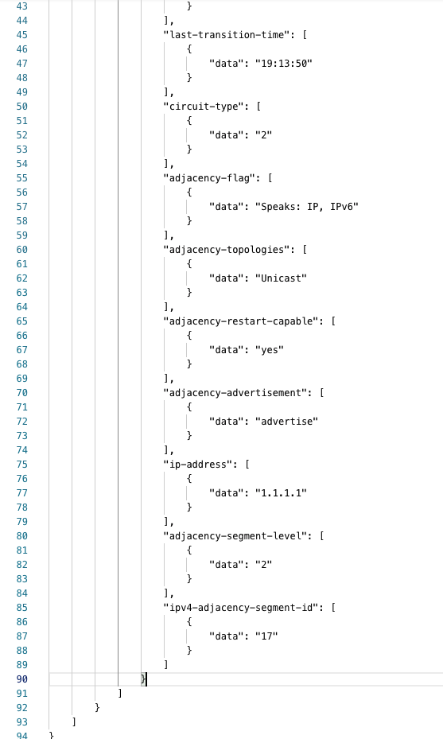
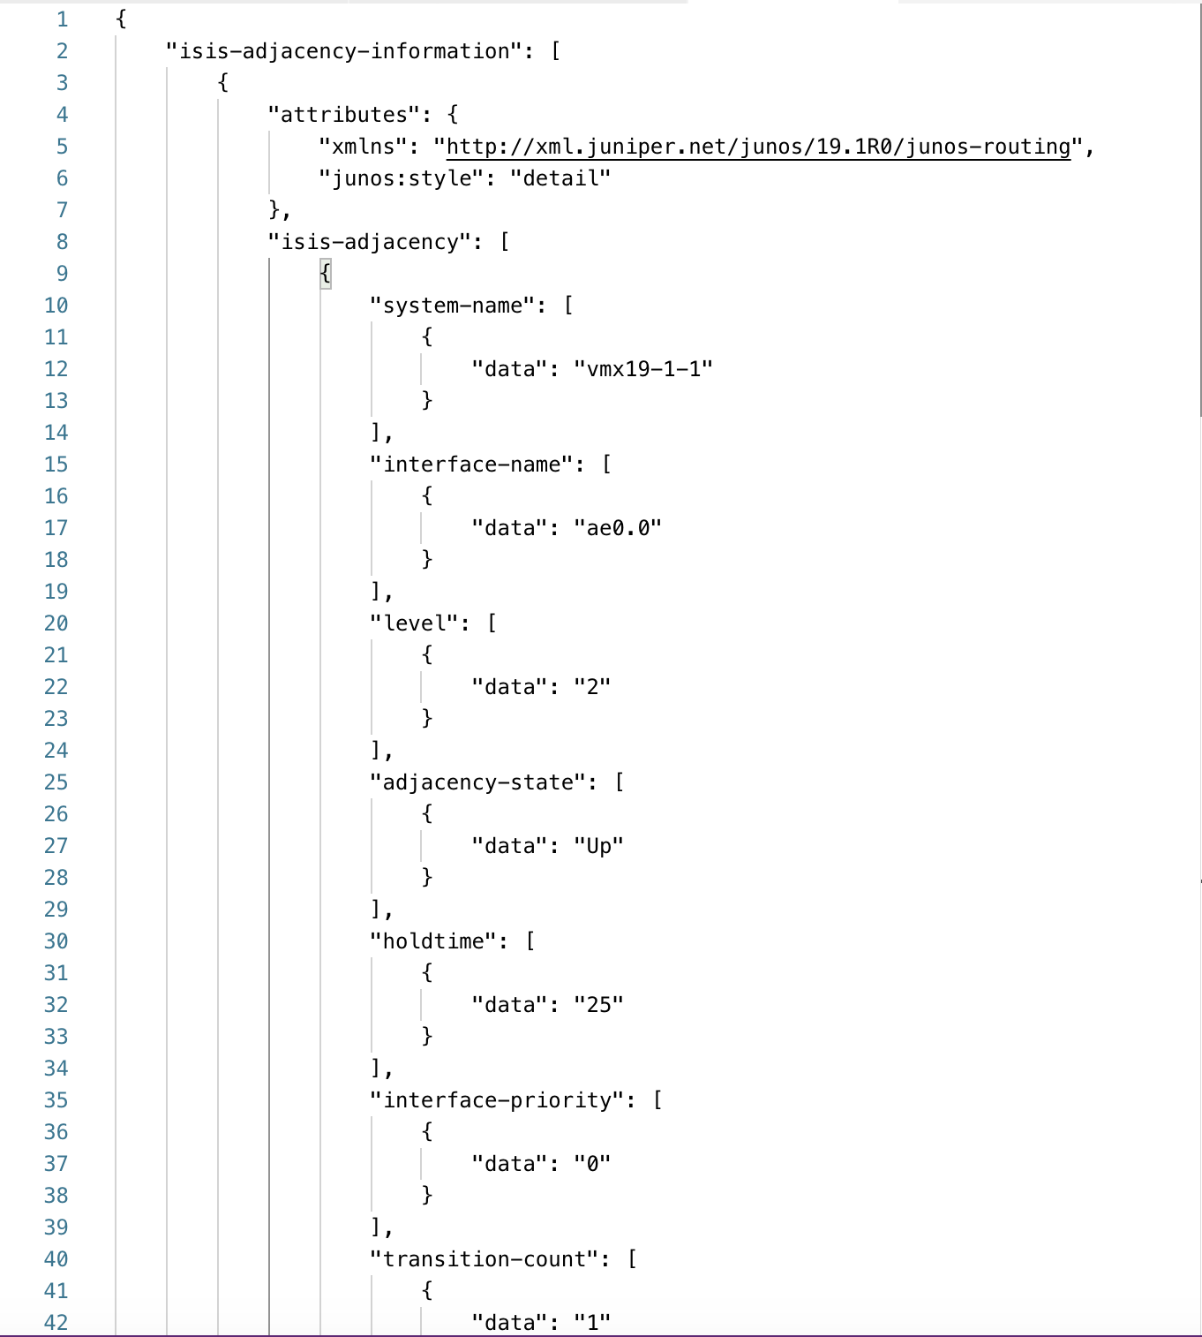
jq – Example Input Data
lab@vmx19-1> show isis adjacency detail
vmx19-1-1
Interface: ae0.0, Level: 2, State: Up, Expires in 21 secs
Priority: 0, Up/Down transitions: 1, Last transition: 04:42:18 ago
Circuit type: 2, Speaks: IP, IPv6
Topologies: Unicast
Restart capable: Yes, Adjacency advertisement: Advertise
IP addresses: 1.1.1.1
Level 2 IPv4 Adj-SID: 17
xrv6-5-1
Interface: ae1.0, Level: 2, State: Up, Expires in 22 secs
Priority: 0, Up/Down transitions: 1, Last transition: 17:32:54 ago
Circuit type: 2, Speaks: IP
Topologies: Unicast
Restart capable: Yes, Adjacency advertisement: Advertise
IP addresses: 1.1.1.5
Level 2 IPv4 Adj-SID: 16
Notes:
What is jq is used for give a brief overview.

Slide 25
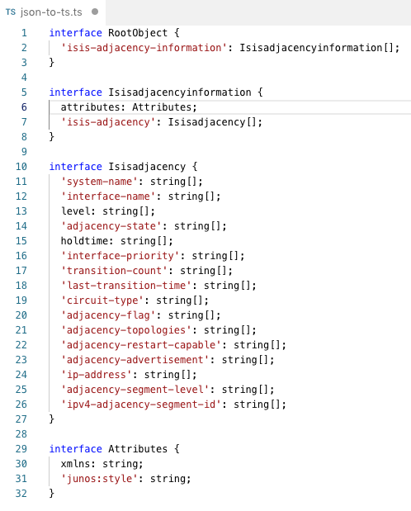
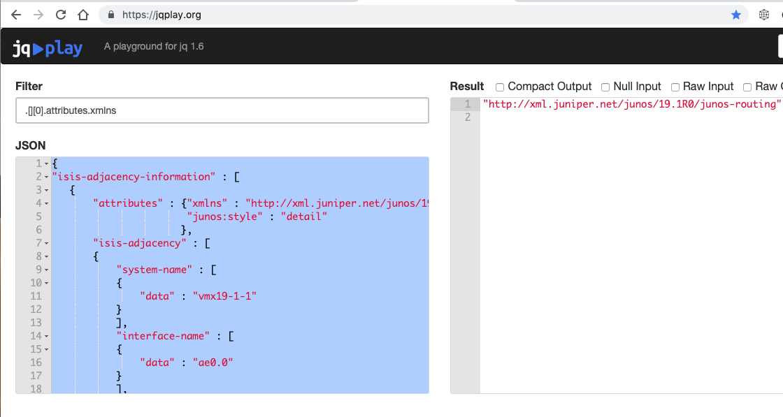
jq - Understanding JSON Schema
jq '.[][0].attributes.xmlns'
.[] returns each element of the array returned in the response, one at a time

Slide 26
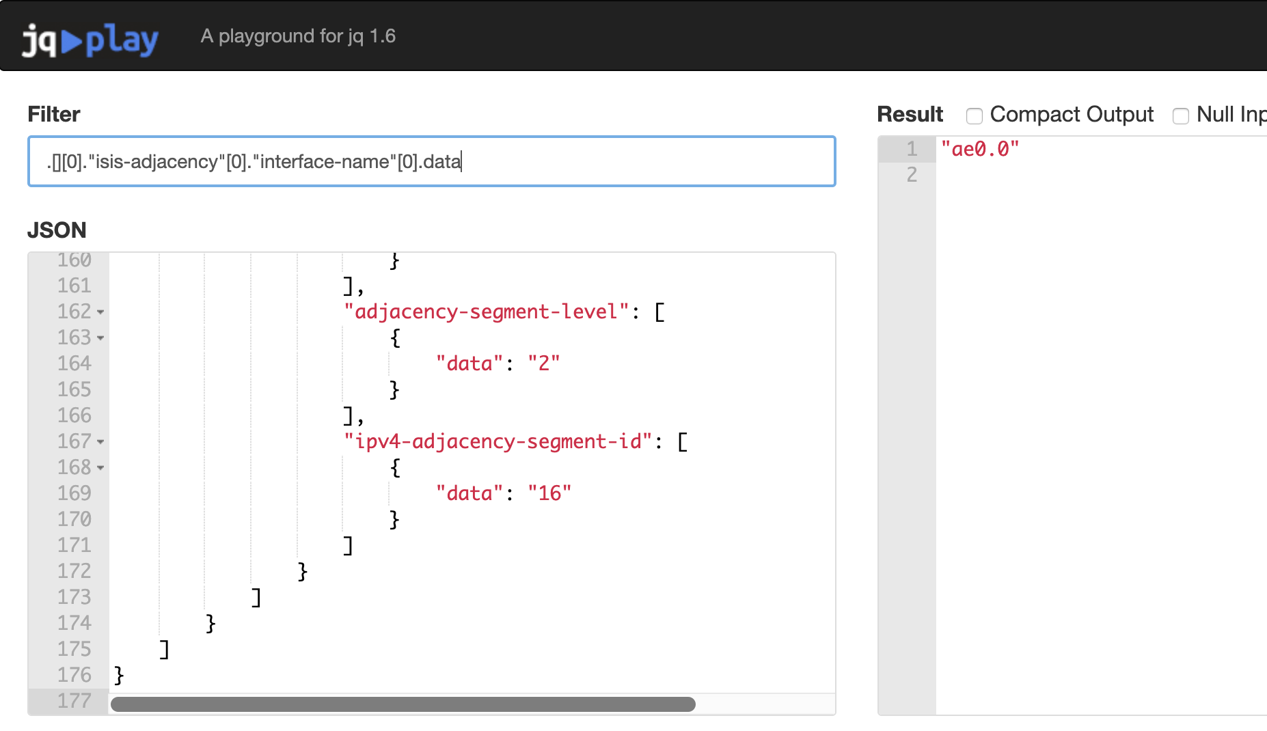
jq- JSON Path to jq Command
jq '.[][0]."isis-adjacency"[0]."interface-name"[0].data'

Slide 27
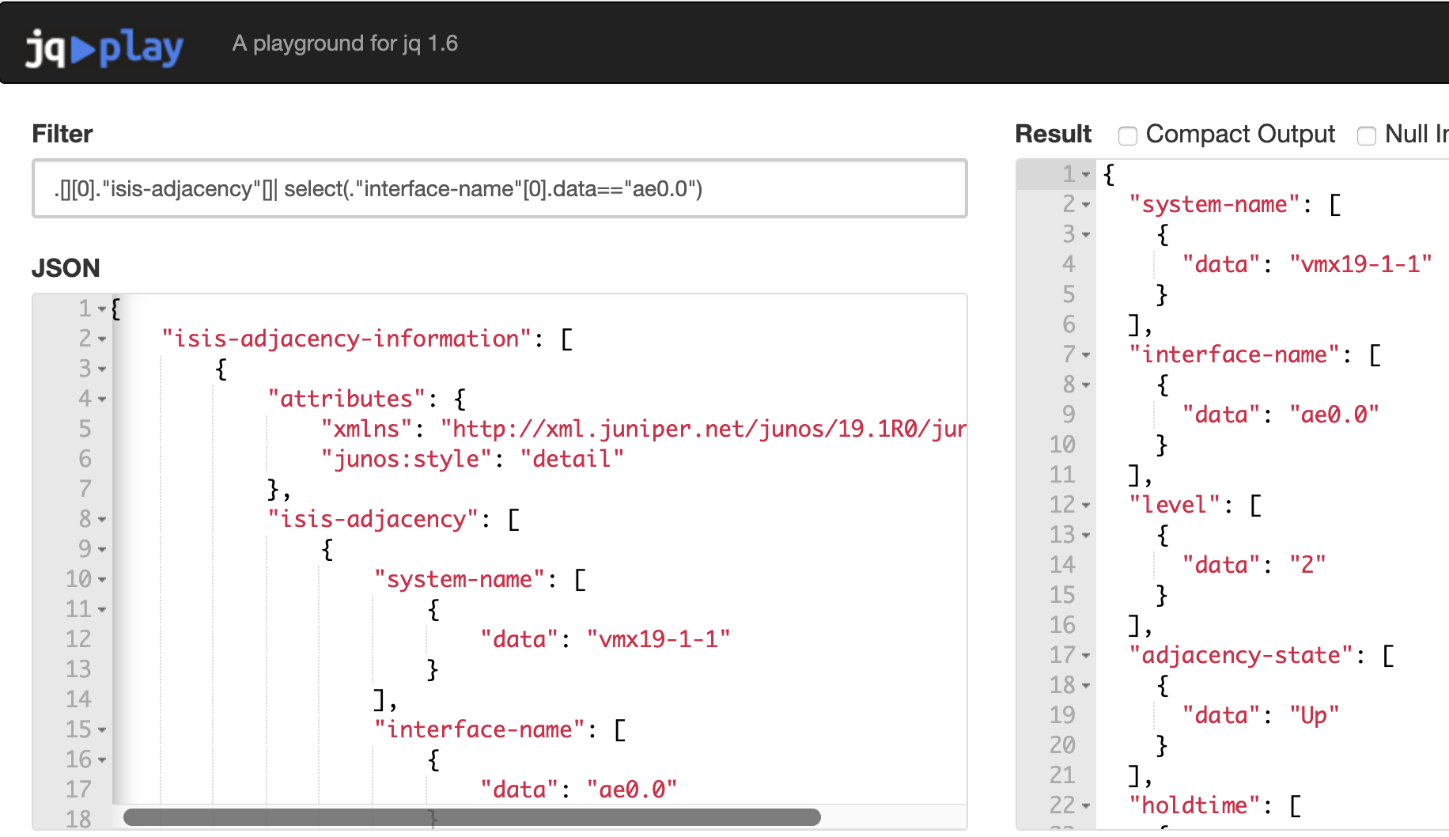
Jq - Filter/Select Example
jq '.[][0]."isis-adjacency"[]| select(."interface-name"[0].data=="ae0.0")'

Slide 28
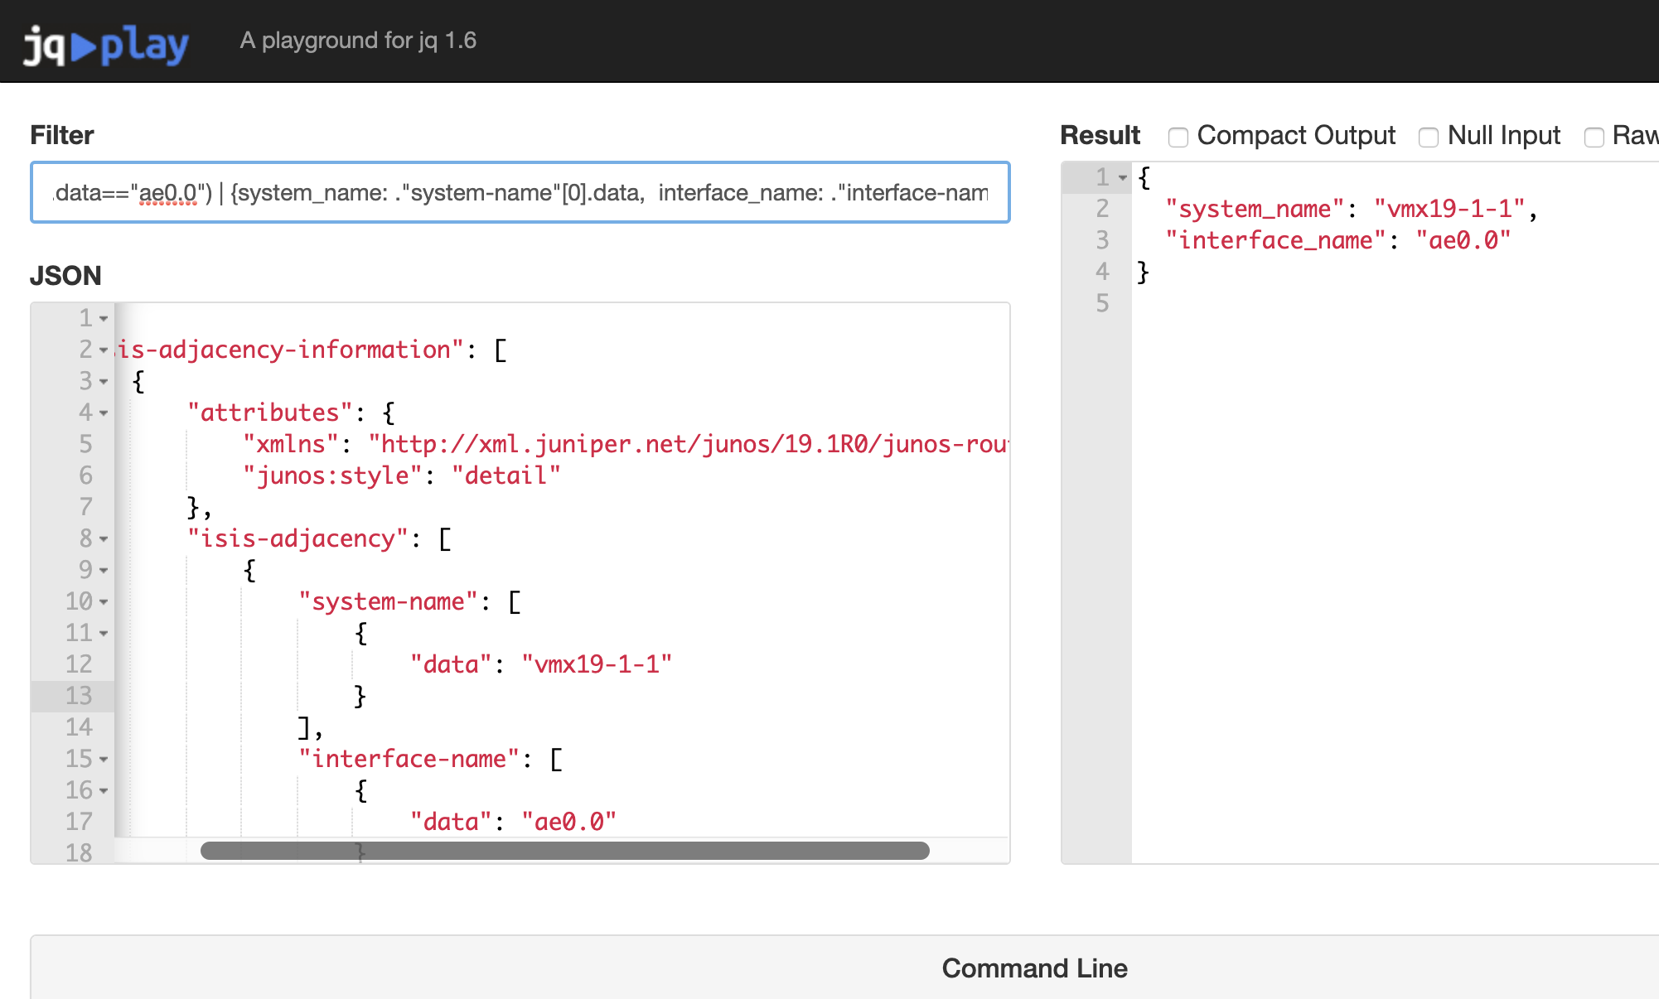
jq - Custom JSON Output
jq '.[][0]."isis-adjacency"[]| select(."interface-name"[0].data=="ae0.0") | {system_name: ."system-name"[0].data, interface_name: ."interface-name"[0].data}'

Slide 29
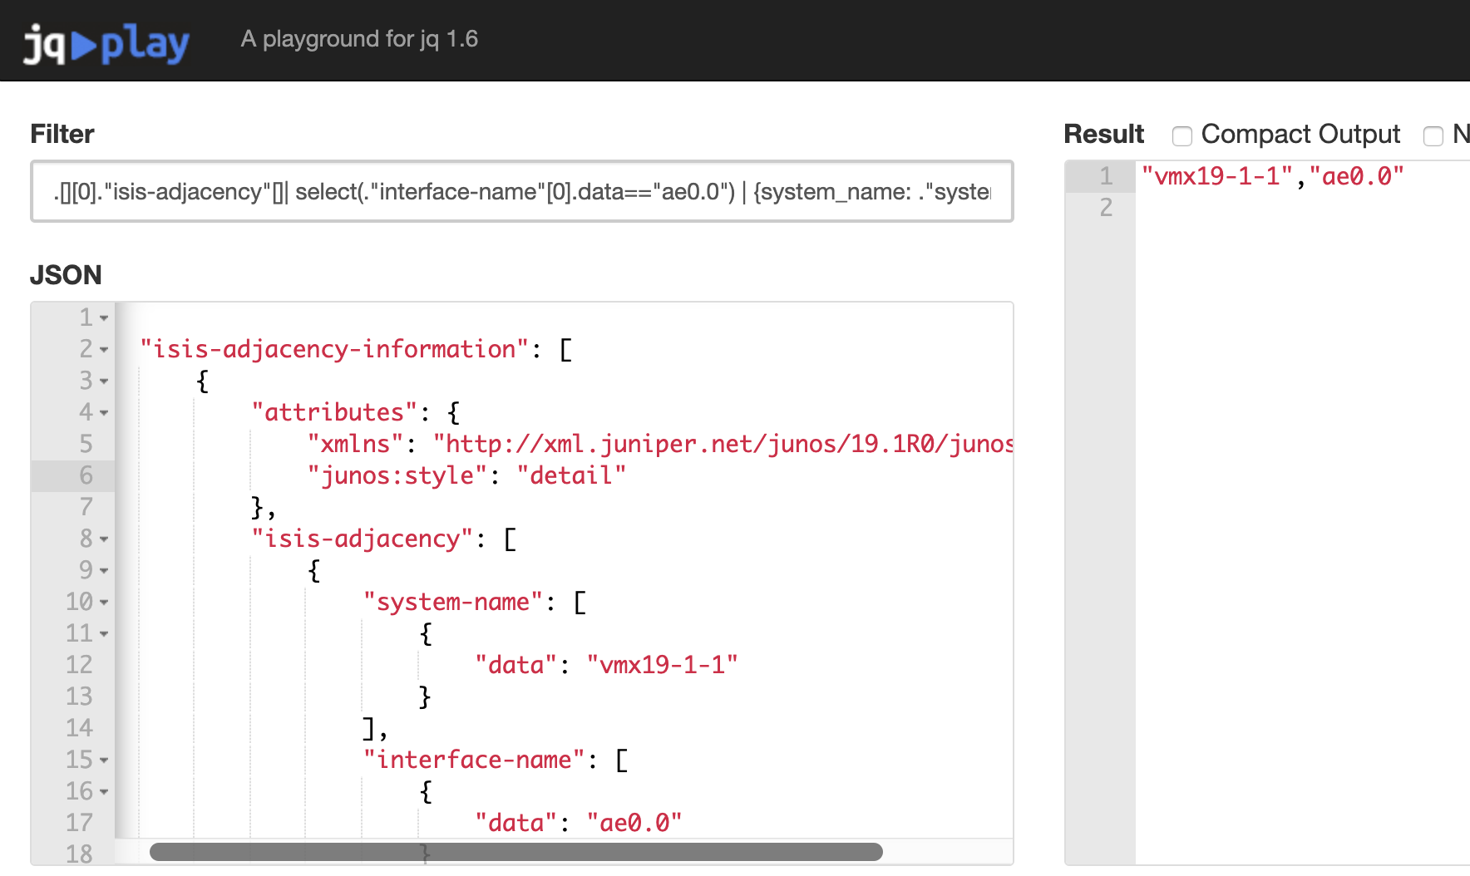
jq - CSV Creation(One Interface Only)
jq --raw-output '.[][0]."isis-adjacency"[]| select(."interface-name"[0].data=="ae0.0") | {system_name: ."system-name"[0].data, interface_name: ."interface-name"[0].data} | [."system_name", ."interface_name"]|@csv’
Precede jq command with echo “system-name,interface-name”; to print CSV header

Slide 30
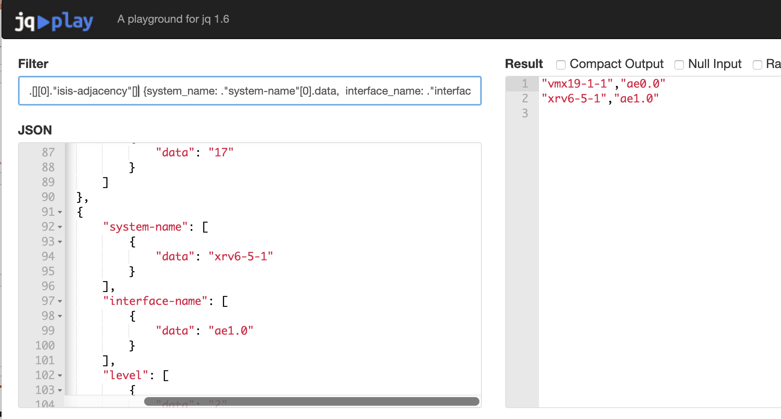
jq - Csv Creation(All Interfaces)
jq --raw-output '.[][0]."isis-adjacency"[]| {system_name: ."system-name"[0].data, interface_name: ."interface-name"[0].data} | [."system_name", ."interface_name"]|@csv'

Slide 31
Grafana and InfluxDB Overview
Grafana is an open source, feature rich metrics dashboard and graph editor for InfluxDB, Graphite, Elasticsearch, OpenTSDB and Prometheus
InfluxDB is an open-source time series database (TSDB) developed by InfluxData

Slide 32
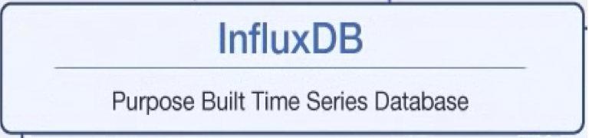
InfluxDB and Grafana
Grafana
http API

Slide 33
Inserting Data Into InfluxDB
rtt.txt
=====
# DDL
CREATE DATABASE rtt
# DML
# CONTEXT-DATABASE: rtt
probe probe=0,time_rtt=84.85,seq=0 1557262142950442240
probe probe=0,time_rtt=19.23,seq=1 1557262143030176000
probe probe=0,time_rtt=24.01,seq=2 1557262143049575936
probe probe=0,time_rtt=16.22,seq=3 1557262143072866816
:
$ influx -import -path=rtt.txt -precision=ns
2019/05/07 17:54:41 Processed 1 commands
2019/05/07 17:54:41 Processed 200 inserts
2019/05/07 17:54:41 Failed 0 inserts

Slide 34
Creating Grafana Dashboard

Slide 35
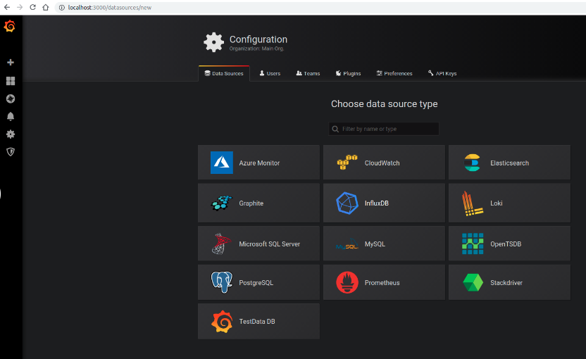
Creating Grafana Dashboard

Slide 36
Creating Grafana Dashboard

Slide 37
Creating Grafana Dashboard

Slide 38
Packages Installed On Your POD
Scapy
Networkx
Exabgp
jq
InfluxDB and Grafana:
You can access Influx via CLI
influx
You can launch Grafana UI using the below link
http://dev{1,2}.pod{1,2..}.oracle.cloud.tesuto.com:3000/login
Credentials – admin/admin

Slide 40
Special Thanks to our Lab Partner

Slide 42
Useful Links
Scapy Cheat Sheet
https://blogs.sans.org/pen-testing/files/2016/04/ScapyCheatSheet_v0.2.pdf
Jq Playground
https://jqplay.org/
Jq Tutorial
https://programminghistorian.org/en/lessons/json-and-jq
Grafana Getting Started
https://grafana.com/docs/guides/getting_started
Git Repo
https://github.com/swahmed-nanog/nanog76_hackathon
Yaml Parser
https://yaml-online-parser.appspot.com/

Slide 43
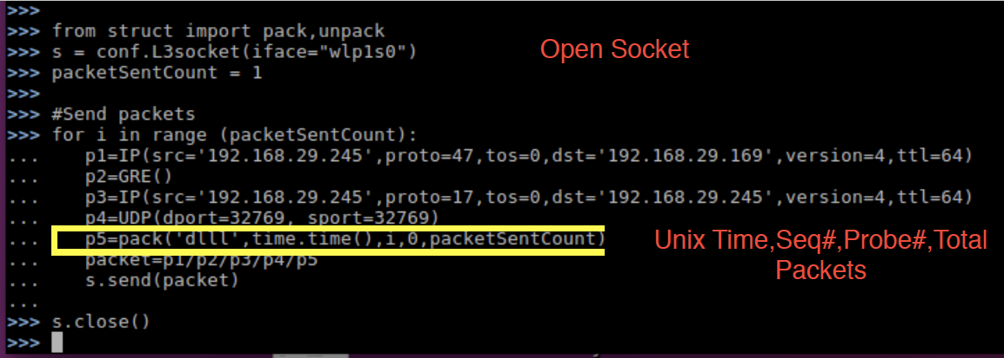
SCAPY – Sending & Receiving IP/GRE/IP/UDP Packet

